Slide 1

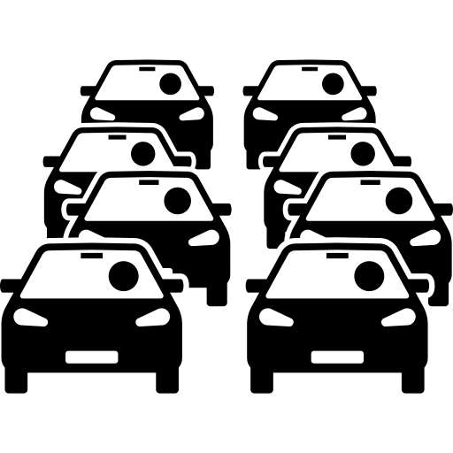











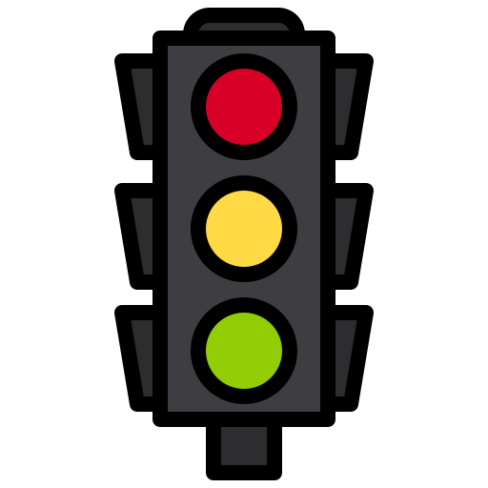
Learn
& adapt
INPUT
PROCESS
OUTPUT
DATA
FLOW
Route
Calculation
Intelligent Route Planning System
Urban Traffic Conditions
Optimal path Navigate

Slide 2

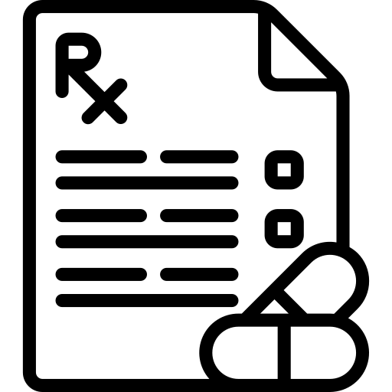
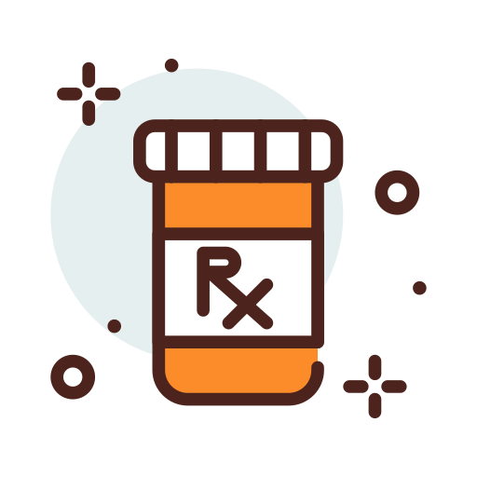


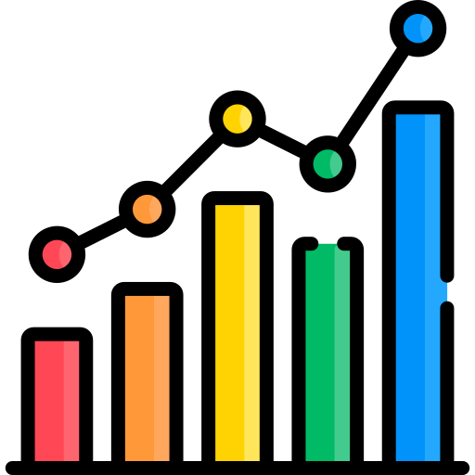
Main Inference Pipeline
Image Prescription images
Raw handwritten Prescription images
Image
Preprocessing
Denoising,
contrast enhancement,
resizing,
normalization,
crop refinement
YOLO Medicine ROI detection
Single class medicine text
Region
detection
Finetuned
TrOcr Recognigation
LoRA fine Tuned TrOcr model
Text Normalization
Lowercasing,
White space cleanup,
Compact text generation
Dictionary Maching and
Correction
Final Medicine Name output
Corrected dictionary
Constrained medicine prediction
Crop
to
Ocr
Crop
Raw
Text
Exact dictinary compact match
Jaro winkler shortlist Lewenstein validation,Best candidate selection
Labeled Finetune Test Dataset
Held out ocr test with ground truth medicine labels
Fine Tuned Trocr on Test Crops
OCR prediction on labeled test set
Ground Truth Comparison
Prediction vs true medicine label
Evaluation Metrices
Pipeline verification
Confirm OCR and correction Performance using labeled test data
Exact match accuracy
Compact match accuracy
CER,WER,corrected vs Rejected cases
Ground Truth Verification Pipeline

